Slide 1
Street Dance
Physical and Interpretive Skills

Slide 2
Learning Objectives
To understand what physical and interpretive skills are
To understand and be able to recognise how we have developed our skills so far
To be able to learn new material and rehearse previously learnt material
To be able to complete a log sheet

Slide 3
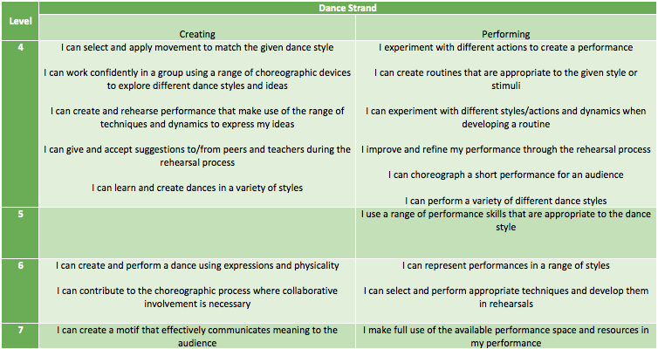
Success Criteria

Slide 4
Physical Skills
We have been developing ourselves as dancers over the last few weeks in lots of different ways
Physical skills simply means the different ways we have been training our body to make us better dancers
What skills have we used and how have we improved as dancers?

Slide 5
Balance
We have been practising the jumps and slides in our dance to make sure we don’t fall over or wobble
Practising our technical routine (handstands and tricks)
Practising our stretches in warm up and cool down

Slide 6
Coordination (performing different movements at the same time)
We have practiced this with our hand pattern (shoulder shoulder change change). It requires use to do lots of things at once and to concentrate. This helps improve our coordination
Our tapping pattern (outside, inside, down clap, down up down) helps improve our coordination at speed

Slide 7
Flexibility (how bendy you are)
1. We have practiced this in our warm up. All the stretches we do at the start are designed to help improve our flexibility, allowing us to perform more movements to a higher standard
2. For example, touching our toes helps improve the flexibility in our legs
3. Which other body parts do we develop?

Slide 8
Stamina (how long you can perform for
1. We have practiced this by making our rehearsal slots longer and longer, meaning you have all become fitter
2. This is important if you want to perform in musicals/concerts as a backing dancer. Professionals can perform up to 3 hours a night after rehearsals!

Slide 9
Extension (how big you make the movements)
1. We have practiced this by rehearsing movements so we are confident with them, allowing us then to focus on the quality of the movement
2. By imagining we are performing in front of a huge audience so the people at the back can see everything we do

Slide 10
Interpretive skills
These are the skills we use to improve the performance quality of our movements so they look better on stage.
You need to demonstrate at least two in your performance
These are the extra things you do on top of simply performing the movements, to make them look amazing on stage.

Slide 11
Use of space
We have practiced this by making sure we are stood in our lines
Also by making sure that when we move (e.g walking forward at the start) we do it as a line and keep our spacing correct, both between the people in our line, and the lines in front and behind.

Slide 12
Learning and performing movements accurately
We have practiced this by going over new material slowly to counts, then with music
Also by revisiting material we have learned previously and making sure we are all doing it at the same time in the same way

Slide 13
Timing
We have practiced this by slowly breaking trickier sections down to make sure we are performing the material at the same time
We have also practised this using the counts at the start when each line takes it in turns to come in. This is called a canon.

Slide 14
Projection
This is similar to extension
We have practiced this by making sure we are facing the right way
And by practicing making the movements as big as possible, so the movements ‘explode’ out of the stage towards the audience

Slide 15
Focus (being focused on the dance, being in the right place, being still when you need to be)
We have practiced our ‘focus’ by making sure we are stood still, arms by our side, facing the correct way before we begin to perform and when we are waiting to perform.
We have also practiced it by going over sections slowly, making sure we are facing our bodies of faces the correct way

Slide 16
Warm up GROUP 3 TO LEAD THIS WEEKS WARM UP.

Slide 17
Lets Dance!
Recap last weeks choreography
Learn new material
Cool down
Log sheets

Slide 18
CREATIVITY
Recap the movement material you created last week in your small groups, which should include.
The Jerk
The Dougie
The Uprock
JUMPS
TRAVELLING
TURNS
FREEZES
REHEARSE ALL OF THE MOVEMENT JOINED TOGETHER.

Slide 19
CREATIVITY
CREATE THE END SECTION OF YOUR DANCE.
CREATE YOUR ENDING POSITION OF YOUR DANCE. THINK ABOUT USING LEVELS, DIFFERENT SHAPES OR MAYBE A LIFT.
REHEARSE ALL OF THE MOVEMENT JOINED TOGETHER.

Slide 20
Plenary
What have you enjoyed?
What have you found challenging?
What have you learnt?
How have you progressed?
What can you improve on next time?
Well done!

